Slide 1
Adversarial Search and Games

Slide 2
In competitive environments, there are two or more agents have conflicting goals, giving rise to adversarial search problems.

Slide 3
Games discussed in AI are commonly two player games
– zero sum games – one player’s win is the other’s loss.
A game can be defined with the following elements
S₀ : Initial State which shows how the game is set up at the start
To-move(s) : The player whose turn it is to move in state s
Action(s) : set of legal actions in s
Result(s, a) : The transition model which defines the state resulting from taking an action a from s
Is-terminal(s) : true, when game over otherwise false
Utility (s, p) : objective function /payoff function – numerical value player gets at the end of the game – in chess 0, 1, or 1/2

Slide 4
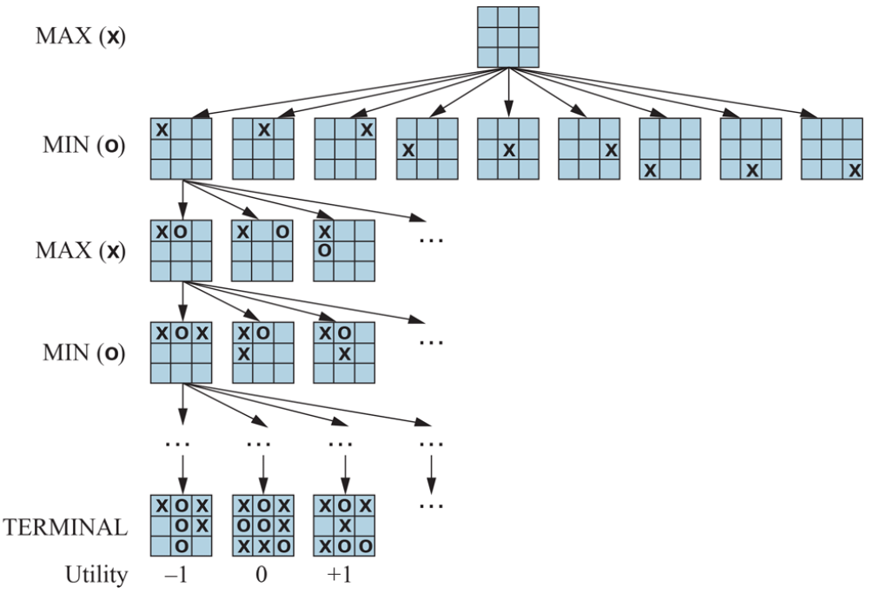

Slide 5
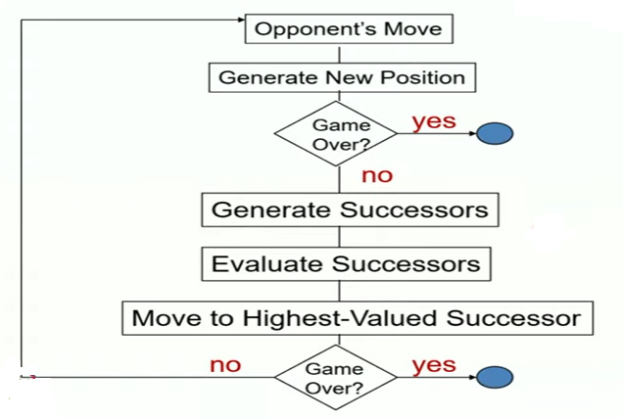

Slide 6
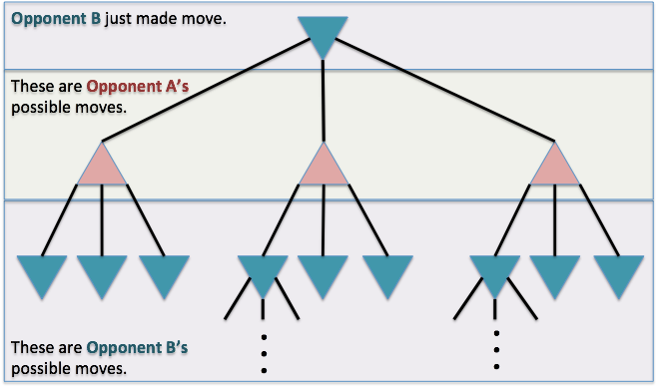
Multi(two) player game
A root node is the current state of the board after Opponent B makes a move, and it’s Opponent A’s turn. So Level 1 contains nodes representing Opponent A’s possible moves, and Level 2 contains nodes representing Opponent B’s possible moves for each and every possible move Opponent A can make back in Level 1.
Utility – “score” each possible move based on its potential to result in a win.
How utility is calculated is entirely up to the domain

Slide 7
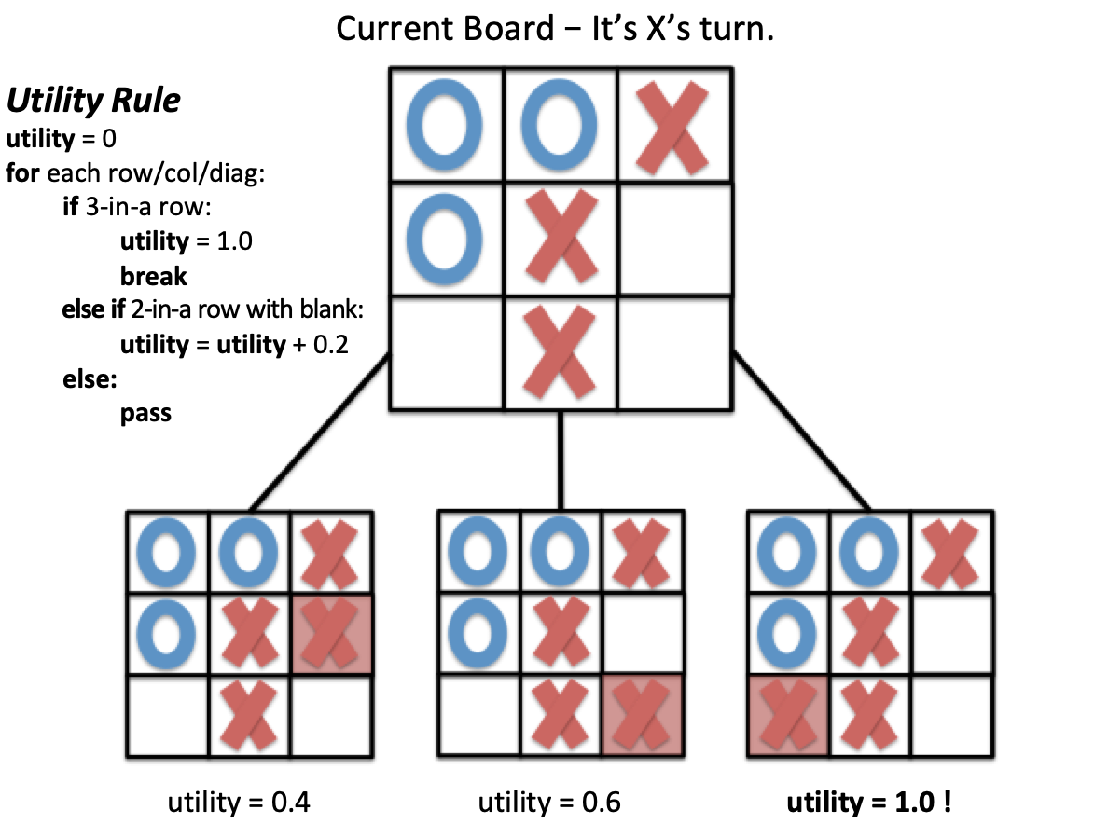
For each row, column, and diagonal, if we have 3 X’s in-a-row, we have won the game and should assign a utility of 1.0. If we have scenarios where we have a row, column, or diagonal with 2 X’s and 1 blank square, our utility should be 0.2 times the number of scenarios where this occurs.”

Slide 8
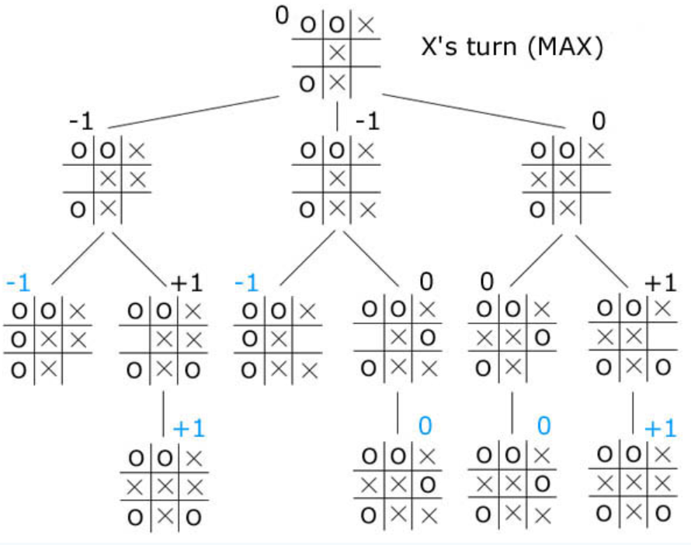
Game tree for tic tac toe.
Each node represents a board position, and the children of each node are the legal moves from that position.
For each position, its score will be
positive if favorable for player 1,
negative if favorable for player 2,
Player 1 is 'X', player 2 is 'O’,
Score : +1 for a win by 'X’,
-1 for a win by 'O’,
0 for a draw.

Slide 9
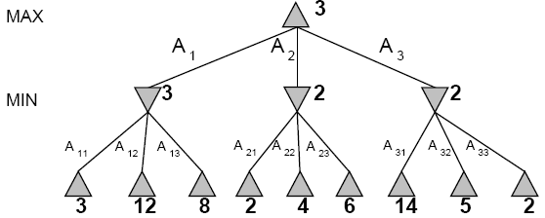
Minimax Strategy Two player game tree

Slide 10
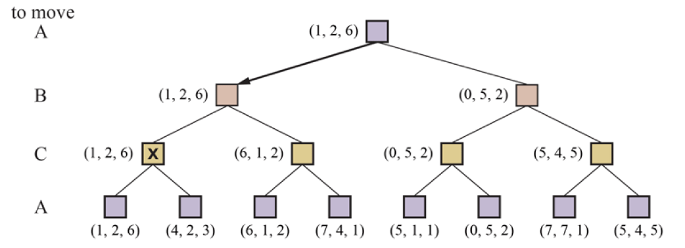
Minimax Strategy Three player game tree

Slide 11
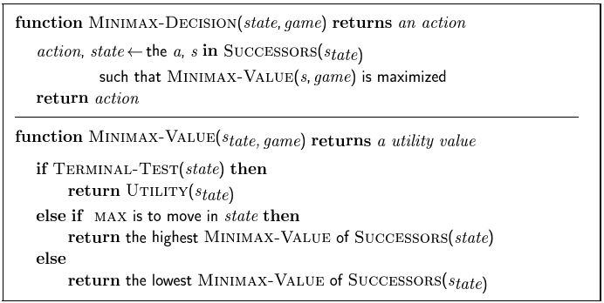
Minimax Algorithm

Slide 12
The MinMax algorithm performs a complete depth-first exploration of the game tree.
The time complexity of MinMax tree is O(b^{m}) , m – maximum depth of the tree and b – number of legal moves
The space complexity is O(bm)

Slide 13
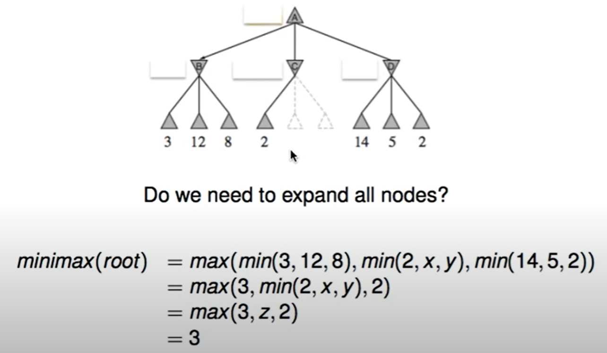
Alpha beta pruning- intuition
Alpha–beta pruning is a search algorithm that seeks to decrease the number of nodes that are evaluated by the minimax algorithm in its search tree.
Do we need z

Slide 14
Alpha-beta pruning is a modified version of the minimax algorithm.
In the minimax search algorithm that the number of game states we have to examine are exponential in depth of the tree.
Alpha-beta pruning. Alpha-beta pruning can be applied at any depth of a tree, and sometimes it not only prune the tree leaves but also entire sub-tree.

Slide 15
Alpha: The best (highest-value) choice we have found so far at any point along the path of Maximizer. The initial value of alpha is -∞.
Beta: The best (lowest-value) choice we have found so far at any point along the path of Minimizer. The initial value of beta is +∞.
The Alpha-beta pruning to a standard minimax algorithm returns the same move as the standard algorithm does, but it removes all the nodes which are not really affecting the final decision but making algorithm slow. Hence by pruning these nodes, it makes the algorithm fast.

Slide 16
The Max player will only update the value of alpha.
The Min player will only update the value of beta.
While backtracking the tree, the node values will be passed to upper nodes instead of values of alpha and beta.
We will only pass the alpha, beta values to the child nodes.

Slide 17
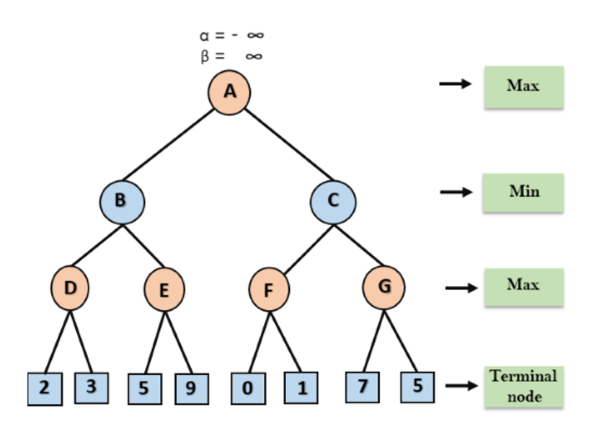

Slide 18

Step 1: At the first step the, Max player will start first move from node A where α= -∞ and β= +∞, these value of alpha and beta passed down to node B where again α= -∞ and β= +∞, and Node B passes the same value to its child D.

Slide 19
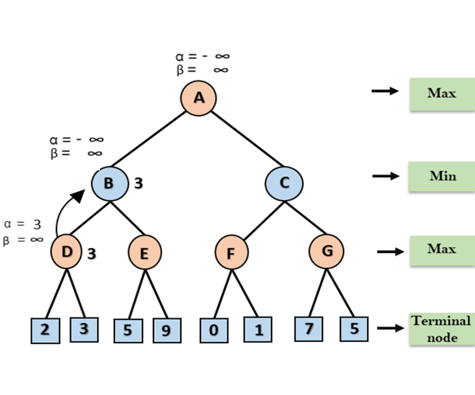
Step 2: At Node D, the value of α will be calculated as its turn for Max.
The value of α is compared with firstly 2 and then 3, and the max (2, 3) = 3 will be the value of α at node D and
node value will also 3.

Slide 20
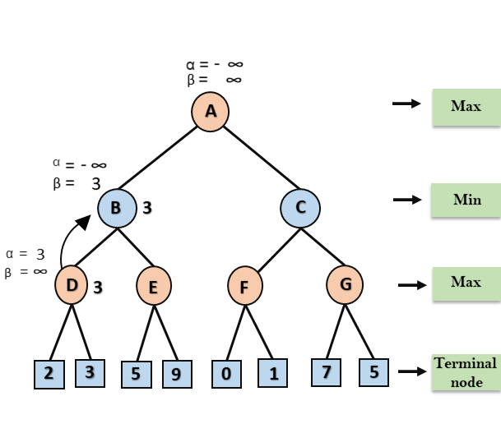
Step 3: Now algorithm backtrack to node B, where the value of β will change as this is a turn of Min,
Now β= +∞, will compare with the available subsequent nodes value, i.e. min (∞, 3) = 3,
hence at node B now α= -∞, and β= 3

Slide 21
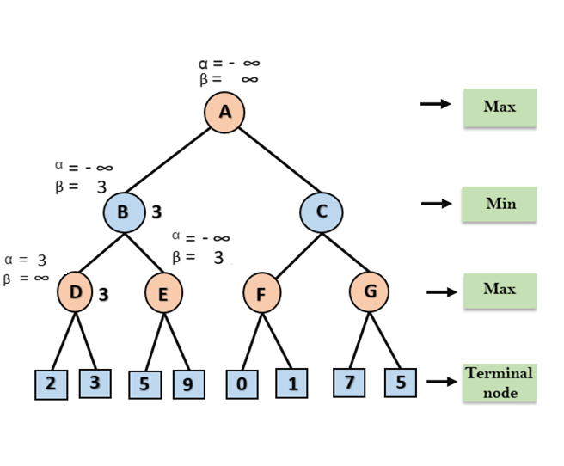
In the next step, algorithm traverse the next successor of Node B which is node E, and the values of α= -∞, and β= 3 will also be passed.

Slide 22
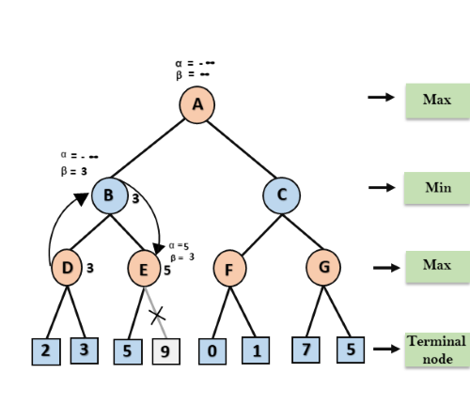
Step 4: At node E, Max will take its turn, and the value of alpha will change.
The current value of alpha will be compared with 5, so max (-∞, 5) = 5,
hence at node E α= 5 and β= 3, where α>=β, so the right successor of E will be pruned, and algorithm will not traverse it, and
the value at node E will be 5.

Slide 23
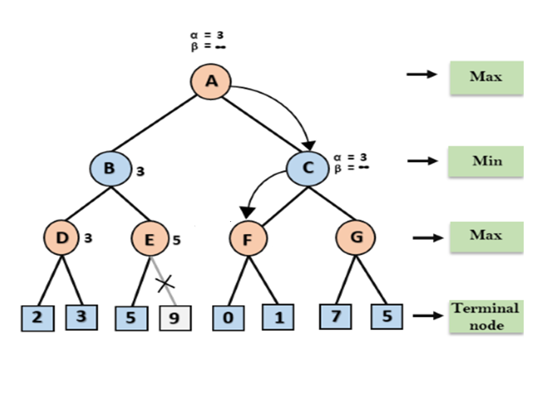
Step 5: At next step, algorithm again backtrack the tree, from node B to node A.
At node A, the value of alpha will be changed the maximum available value is 3 as max (-∞, 3)= 3, and β= +∞, these two values now passes to right successor of A which is Node C.
At node C, α=3 and β= +∞, and the same values will be passed on to node F.

Slide 24
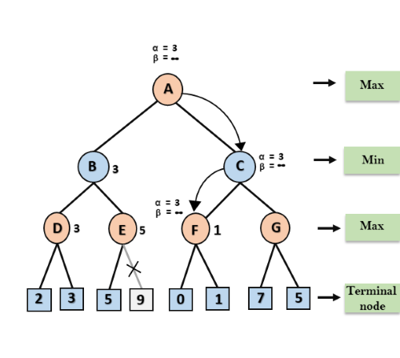
Step 6: At node F, again the value of α will be compared with left child which is 0, and max(3,0)= 3, and then compared with right child which is 1, and max(3,1)= 3 still α remains 3, but the node value of F will become 1.

Slide 25
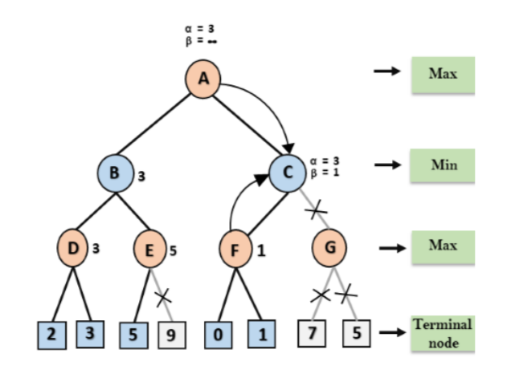
step 7: Node F returns the node value 1 to node C, at C α= 3 and β= +∞, here the value of beta will be changed, it will compare with 1 so min (∞, 1) = 1.
Now at C, α=3 and β= 1, and again it satisfies the condition α>=β, so the next child of C which is G will be pruned, and the algorithm will not compute the entire sub-tree G

Slide 26
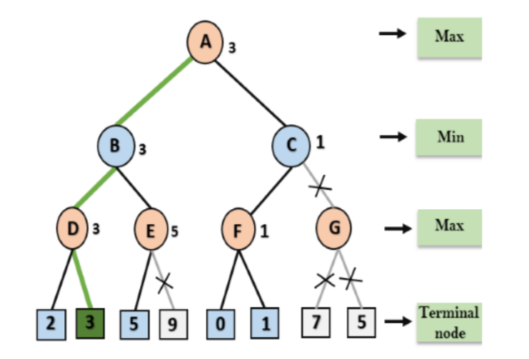
Step 8 : C now returns the value of 1 to A here the best value for A is max (3, 1) = 3. Following is the final game tree which is the showing the nodes which are computed and nodes which has never computed. Hence the optimal value for the maximizer is 3 for this example

Slide 27
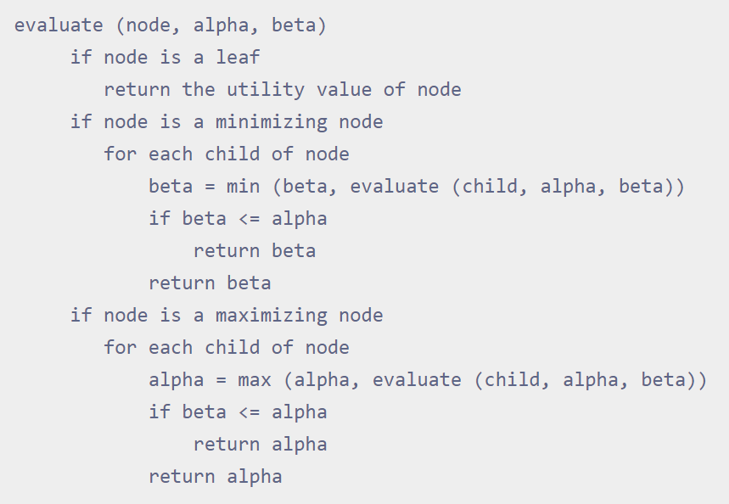

Slide 28
